Slide 1

23CS1512 Socially Relevant MiniProject.
Zerobite: A Real-Time Food Donation and Waste Management System?
SDG Goals
TEAM DETAILS
SDG 2: Zero Hunger
NAME: ALIN JEBITHA B / 211423104032
NAME: AMRIN JOSHIGA A / 211423104036
SDG 12: Responsible Consumption and Production
SDG 13: Climate Action
BATCH NUMBER : A9
Domain: Full Stack Development
Mrs. K. Cinthuja, M.E Assistant Professor
Coordinator Name & Designation
Date : 31/10/2025
Dr.Kavitha Subramaniam Professor

Slide 2
AGENDA
Abstract
Introduction
Objective
Litreature survey
Problem statement
Architecture diagram
State Diagram
Modules
9.Methodology
10.Testing
11.Validation test Cases
12.Performance analysis
13.Experimental Results
14.Conclusion
15.Future work
16.References

Slide 3
ABSTRACT
Food wastage and hunger continue to be major global problems, with large amounts of edible food discarded while millions remain undernourished.
The lack of a centralized and automated platform leads to delays, inefficiency, and increased food spoilage.
The ZeroBite system aims to bridge this gap by providing a real-time web-based food redistribution platform.
It facilitates digital coordination between food donors, NGOs, and beneficiaries for faster and safer food collection.
The system is built using HTML, SCSS, and JavaScript for the frontend and Django REST Framework with MySQL for the backend.
Donors can easily post food details, including expiry time, quantity, and location, through the web interface.
An integrated live map helps NGOs locate nearby donations, while the expiry module automatically removes expired items.
By promoting transparency, automation, and sustainability, ZeroBite reduces food waste and supports community welfare.

Slide 4
INTRODUCTION
Food wastage and hunger are two deeply interconnected problems that persist globally despite abundant food resources.
Every day, tons of edible food from restaurants, events, and households are discarded instead of being redistributed.
This unused food could potentially feed millions of undernourished people suffering from hunger and malnutrition.
Improper food management systems and lack of coordination between donors and NGOs worsen the issue.
Food waste also impacts the environment, contributing to greenhouse gas emissions and resource wastage.
According to global studies, nearly one-third of all food produced is wasted before consumption.
The imbalance between food availability and food access highlights the need for a better redistribution system.
Current donation practices are manual, unstructured, and time-consuming, leading to inefficiency.

Slide 5
INTRODUCTION
Traditional methods depend on phone calls, emails, or social media messages for coordination.
These methods often result in communication gaps and delayed pickups, causing food spoilage.
Many existing food donation systems lack automation and require constant human intervention.
There is no standard mechanism for tracking food expiry times or verifying freshness.
Geolocation or route optimization is rarely implemented, making it hard to match nearby donors and NGOs.
As a result, valuable time is lost in locating and collecting food before it expires.
The absence of real-time data updates reduces system transparency and trust among users.
A digital, centralized platform can eliminate manual inefficiencies and connect all stakeholders instantly.
Such a system should include features like real-time tracking, expiry validation, automated notifications, and secure data management.
By integrating modern web technologies and automation, food redistribution can become faster, safer, and more reliable.

Slide 6
OBJECTIVE
To develop a real-time web-based platform that connects food donors, NGOs, and volunteers, enabling efficient food redistribution through a single centralized system.
To reduce food wastage by ensuring that surplus edible food from restaurants and events is collected and delivered to the needy before expiry.
To implement a secure and role-based authentication system that categorizes users as Donors, NGOs, or Admins for organized access and data management.
To design an automatic expiry detection feature that continuously monitors donations and removes expired items to ensure food safety.
To integrate a live location map that helps NGOs identify nearby food donations and plan quick pickups through real-time navigation.
To ensure seamless data synchronization between frontend and backend using Django REST Framework and MySQL for instant updates and reliability.
To establish a transparent donation tracking mechanism that verifies each transaction from posting to pickup, ensuring accountability and trust.
To incorporate data analytics and reporting tools for monitoring donation patterns, expiry rates, and system performance metrics.
To contribute to social welfare and sustainability goals by aligning with UN SDG 2 (Zero Hunger) and SDG 12 (Responsible Consumption).

Slide 7
LITERATURE REVIEW
[1] Helping Hand: An Interactive Mobile Application Featuring Underprivileged People Assistance With Donation and Beneficiary Selection Facilities (2023)
Aspect | Details
Author | Chowdhury, Mahfuzulhoq and Ahmad, Alve.
Summary | Developed a digital platform connecting donors with beneficiaries through real-time interaction and food listing features.
Relevance | Demonstrates the importance of technology-based solutions for donation coordination.
Gaps | Lacks expiry management, live location tracking, and admin monitoring.
Impact | Serves as a base for ZeroBite’s automation, expiry validation, and geolocation features.

Slide 8
LITERATURE REVIEW
[2] Food Waste Management System in the Midst of a Food Crisis (2023)
Aspect | Details
Author | Kruthika V., Lavanya H.R., Mahalakshmi, Ranju P.S.R., Priyanka H.L., and Sindhu K.S.
Summary | Proposed a web platform to manage food donations during crisis situations.
Relevance | Shares the same goal of connecting donors and NGOs.
Gaps | Lacks live map tracking and automatic expiry validation.
Impact | Strengthens the concept behind ZeroBite’s real-time tracking and expiry control.

Slide 9
LITERATURE REVIEW
[3] Recent Advances on Physical Technologies for Pretreatment of Food Waste (2023)
Aspect | Details
Author | Gallego-García, María, et al.
Summary | Reviewed advanced methods for sustainable waste reuse and pretreatment technologies.
Relevance | Supports the role of automation and smart systems in food management.
Gaps | Focused on industrial waste processing rather than redistribution.
Impact | Encourages using technology-driven automation as integrated in ZeroBite.

Slide 10
PROBLEM STATEMENT
Food wastage and hunger remain interconnected global problems, with large amounts of edible food wasted while millions suffer from hunger.
Restaurants, events, and households discard surplus food daily, even as nearby communities face food insecurity.
The absence of a centralized, automated platform leads to poor coordination and delayed redistribution.
Manual processes such as phone calls or social media coordination are inefficient and prone to errors.
Existing systems lack real-time tracking and automation, reducing speed and effectiveness in food collection.
Expiry-time validation is often missing, leading to potential distribution of unsafe or spoiled food.
Environmental pollution increases as food waste contributes to methane emissions and resource wastage.
A smart digital solution is essential to connect donors and NGOs in real time for faster, safer food redistribution.

Slide 11
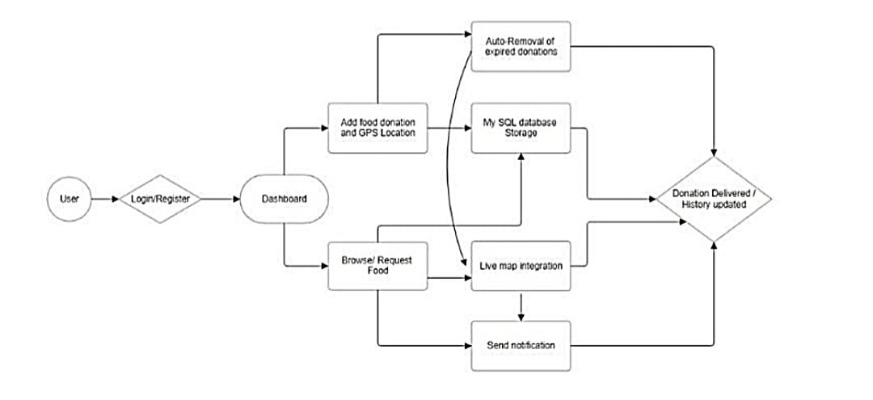
SYSTEM ARCHITECTURE DIAGRAM

Slide 12

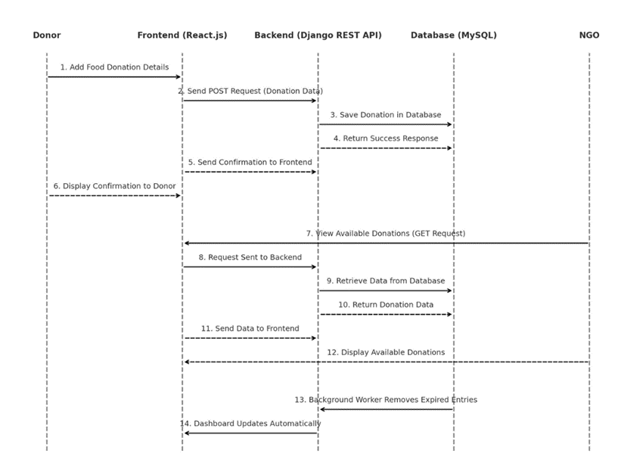
SEQUENCE DIAGRAM

Slide 13
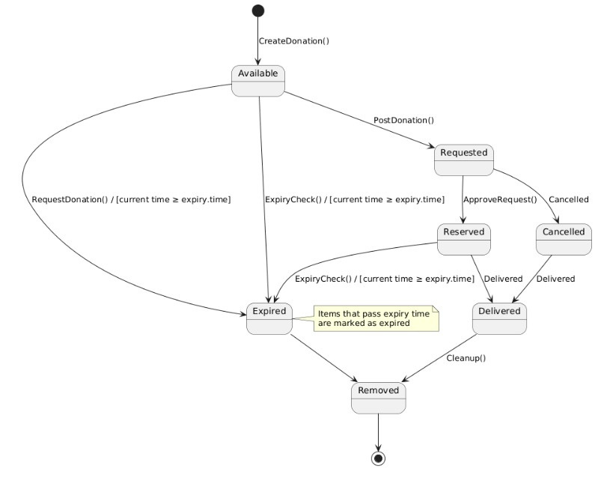
STATE DIAGRAM

Slide 14
MODULES
1. USER AUTHENTICATION MODULE
Ensures only verified users (Donors or NGOs) can securely access and interact with the ZeroBite platform.
It is built using Django REST Framework (DRF) with JSON Web Tokens (JWT) for secure, stateless authentication.
This supports role-based access control (RBAC) to limit actions based on user type (Donor or NGO).
Registration Process:
Collects user details — name, email, password, and role.
Validates all inputs for accuracy and security.
Passwords are encrypted using Django’s PBKDF2 hashing algorithm before storage.
Verified user information is stored in the MySQL database, and a success response is sent to the frontend.
Login and Token Handling:
User logs in with email and password; backend verifies credentials.
If valid, the system generates JWT access and refresh tokens.
The frontend stores tokens securely and includes them in each request for authorization.
Expired tokens are refreshed using the refresh token to maintain secure sessions.
Role-Based Access:
Donors: Can add and manage their own food donation posts.
NGOs: Can browse, request, and confirm available donations.
Any unauthorized action outside a user’s role is denied automatically by the backend.

Slide 15
MODULES
2. FOOD DONATION MANAGEMENT MODULE
The Food Donation Management Module is the core component of the ZeroBite System, responsible for managing the complete donation lifecycle — from creation and storage to viewing and confirmation.
It seamlessly integrates the React.js frontend with the Django REST Framework backend, ensuring smooth data flow and communication between users and the server.
All donation records are securely stored in a MySQL database, maintaining data integrity, accuracy, and real-time accessibility for both donors and NGOs.
Donation Process:
Donors log in and create donation entries with food type, quantity, expiry time, and pickup location.
Frontend validates inputs and sends data to the backend via POST API.
Backend verifies the donor, stores details in the Donation Table, and returns a success response.
Viewing and Access:
NGOs can view available, non-expired donations through the dashboard using GET API calls.
New donations appear instantly without page refresh, ensuring real-time updates.
Management and Tracking:
Donors can update or withdraw donations; expired ones can’t be edited.
All donation actions are logged for transparency and accountability.
Follows RESTful design for fast performance and accurate data handling.

Slide 16
MODULES
3. AUTOMATIC EXPIRY REMOVAL MODULE
The Automatic Expiry Removal Module automatically detects and removes expired food donations to ensure food safety and reliability within the ZeroBite system.
It operates silently in the background, checking expiry times at regular intervals without requiring any manual action.
When donors add a donation, they are required to specify an expiry time (Tₑ), which is stored in the MySQL database.
The system continuously compares the current time (Tₙ) with the expiry time (Tₑ) to determine whether a donation remains valid or needs to be marked as expired.
EXPIRY TIME LOGIC
Condition for expiry:
If Tₙ ≥ Tₑ, the donation is considered Expired.
Remaining time before expiry:
ΔT = Tₑ – Tₙ
If ΔT ≤ 0, the donation is marked as Expired automatically.

Slide 17
MODULE
4. LIVE MAP INTEGRATION MODULE
The Live Map Integration Module in the ZeroBite system enables real-time connectivity between donors and NGOs through an interactive map interface.
It visualizes donation locations, tracks routes, and ensures quick, efficient food collection.
By integrating location and mapping technologies, this module plays a key role in reducing food wastage and improving coordination.
Automatically captures latitude and longitude of donor locations using the Geolocation API.
Displays all active donations as interactive map markers via the Google Maps API.
Each marker shows important details such as donor name, food type, quantity, and expiry time.
NGOs can click on a marker to view the shortest route for pickup, saving time and preserving food freshness.
The map updates dynamically as new donations are added or old ones expire.
Ensures real-time data accuracy and smooth donor–NGO coordination.
Promotes faster response, efficient logistics, and reduced food wastage across multiple locations.

Slide 18
METHODOLOGY
The proposed system implements secure user authentication and role-based access control to manage user permissions effectively.
Each user is assigned a specific role — Restaurant, NGO, or Volunteer — which determines their access level and functionalities.
Restaurants and event organizers can create and post detailed food donations.
NGOs can browse, filter, and request available food items from nearby donors.
Volunteers play a support role by assisting in collection, transportation, and delivery of food to recipients.
When a donation is created, all essential details such as food name, quantity, expiry time, location coordinates (latitude & longitude), and donor info are stored in the MySQL database.
The system includes a freshness monitoring mechanism that uses a countdown timer to track the remaining valid time for each donation.
The remaining time before expiry is dynamically calculated using the formula:
Remaining Seconds = max(0, (ExpiryTime − CurrentTime) / 1000)
Once the remaining time reaches zero, the donation is automatically flagged as expired and removed from the active donation list.
This feature ensures food safety and hygiene, allowing NGOs to access only safe, non-expired food items, while improving efficiency and trust in the redistribution process.

Slide 19
TESTING
Functional Testing: Conducted to verify the operation of each core module including login, donation posting, expiry removal, and live map tracking.
Usability Testing: Focused on ensuring the interface is simple, responsive, and easily navigable for both donors and NGOs with minimal training.
Performance Testing: Measured how efficiently the system responds under multiple concurrent user requests and database operations.
Security Testing: Validated JWT authentication, encrypted passwords, and secure API communication to prevent unauthorized data access.
Integration Testing: Checked the seamless interaction between frontend, backend, and database layers for error-free synchronization.
Compatibility Testing: Ensured smooth functioning across different browsers and devices, including mobile and desktop platforms.
Load Testing: Evaluated system stability when multiple donations and NGO requests were processed simultaneously.
API Testing: Performed using Postman to verify all REST endpoints return correct data and handle edge cases properly.
Validation Testing: Confirmed that user inputs, expiry checks, and food listings meet all functional and safety requirements.

Slide 20
VALIDATION TEST CASES
Test Case | Input Description | Expected Output | Actual Result
Login Function | Valid username & password | User redirected to dashboard | Pass
Add Donation | Valid donation details entered | Donation saved successfully | Pass
Expiry Check | Expired food entry detected | Automatically removed from list | Pass
Map View | Valid coordinates provided | Live markers displayed on map | Pass
Token Authentication | Expired token used | Access denied with error message | Pass
Role Restriction | NGO tries to add donation | Action blocked by system | Pass

Slide 21
PERFORMANCE ANALYSIS
The system achieved an average response time of under 2 seconds for all major actions such as login, posting, and map updates.
Data synchronization accuracy reached nearly 100%, ensuring all users view updated food listings without delay.
Expiry validation efficiency was recorded at 98%, with automatic removal of expired items verified during testing.
The live map module updated within 1 second, maintaining real-time accuracy of donor and NGO locations.
System uptime measured at 99%, confirming high availability and reliability under normal operating conditions.
Database query performance remained consistent even with large data volumes, ensuring scalability for future expansion.
Error rate was minimal, with most detected issues resolved during early test iterations.
Overall, the system proved to be stable, secure, and responsive, meeting all functional and non-functional requirements.

Slide 22
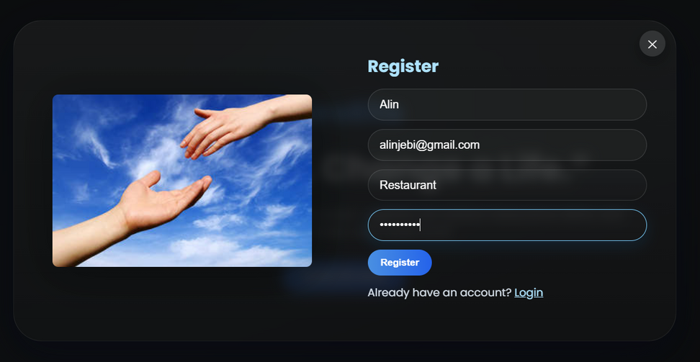
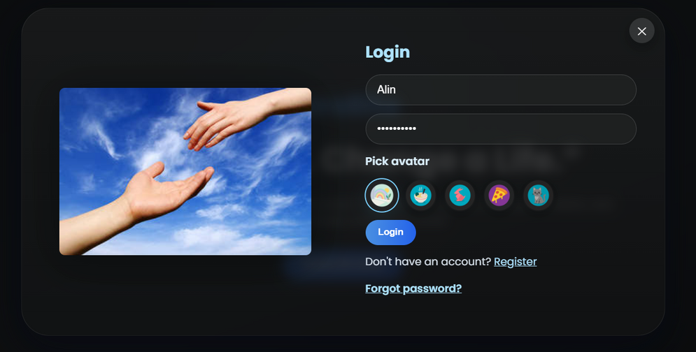
EXPERIMENTAL RESULTS
Registration Page
Login Page

Slide 23
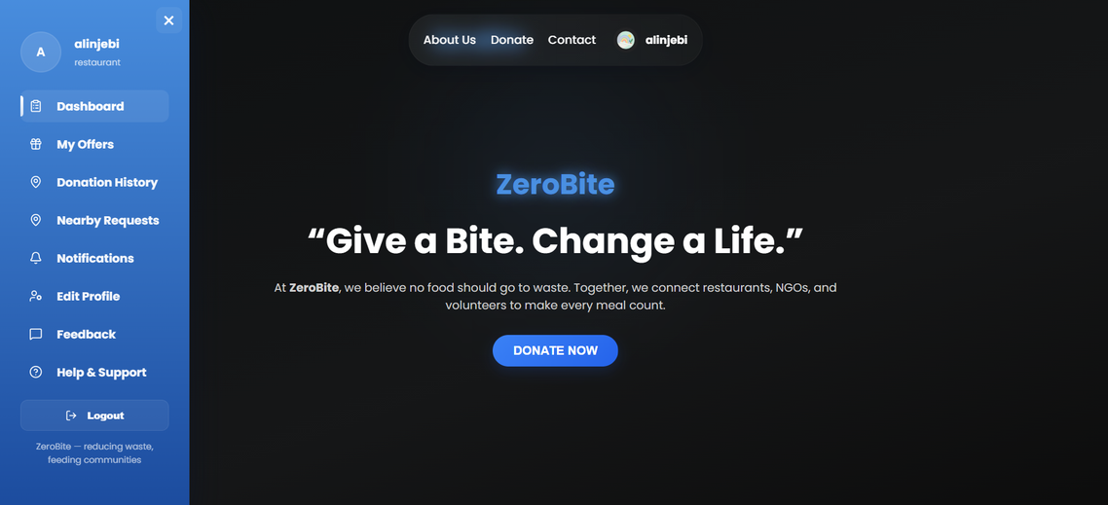
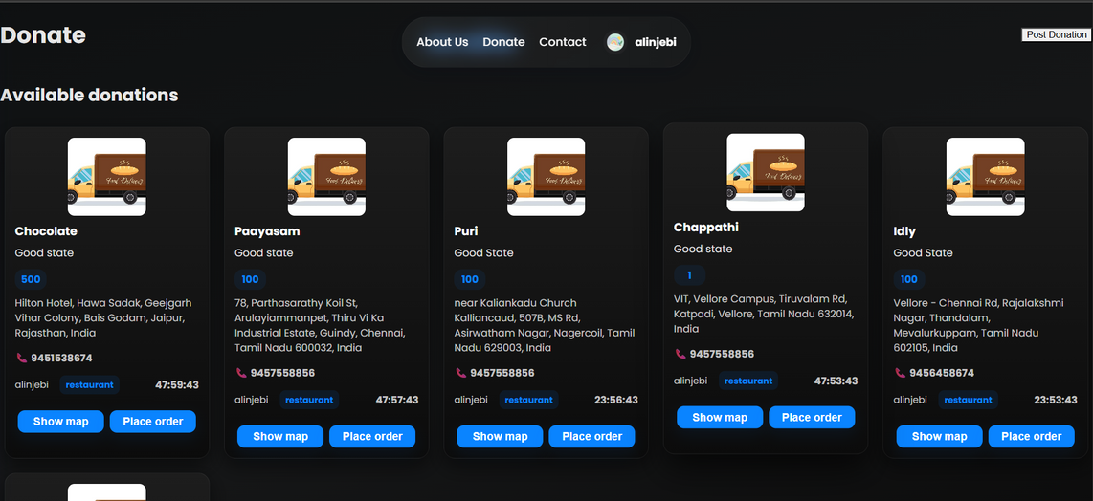
EXPERIMENTAL RESULTS
Donation Page
Dashboard

Slide 24
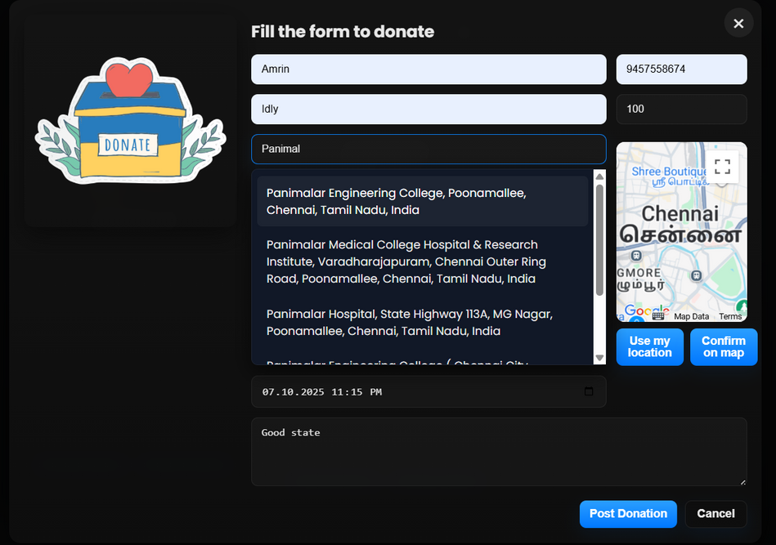
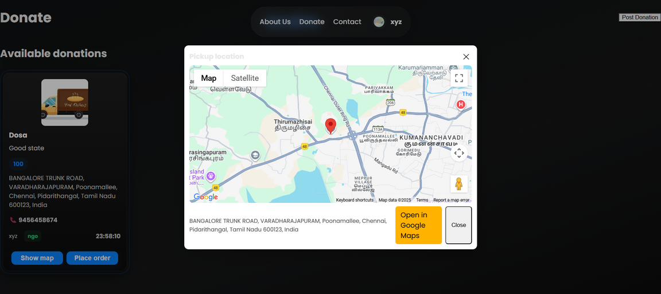
EXPERIMENTAL RESULTS
Location being visible
Donation Form Page

Slide 25
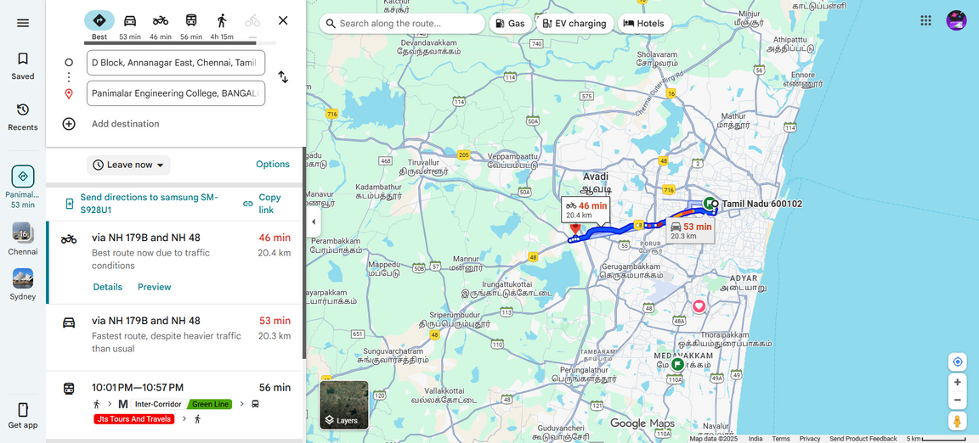
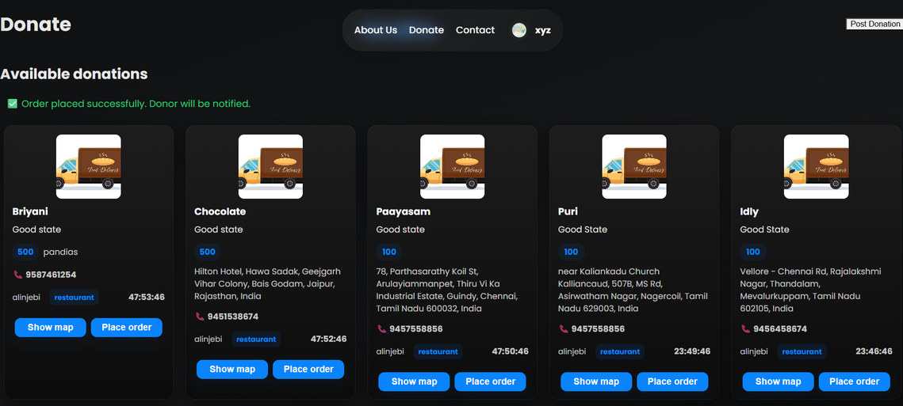
EXPERIMENTAL RESULTS
Track Donation Using Google Map
Order Placed

Slide 26
CONCULSION
The ZeroBite system connects restaurants, event organizers, and NGOs to enable efficient redistribution of surplus food.
It ensures that excess edible food reaches those in need safely and promptly.
The platform allows donors to share precise pickup locations for easy coordination and faster collection.
Expiry time tracking ensures all redistributed food remains fresh and safe for consumption.
The system enhances efficiency and transparency in the food donation and collection process.
Its simple and reliable design makes it easy for users to operate during time-critical situations.
ZeroBite minimizes food wastage by redirecting surplus food to underprivileged communities.
It actively supports hunger relief efforts and strengthens community engagement.
The project encourages social responsibility and sustainability through technology.
Overall, ZeroBite transforms food surplus into a social good, reducing both hunger and environmental impact.

Slide 27
FUTURE STEPS
Mobile Application Development: Expand ZeroBite into mobile platforms for easy access and real-time food management.
AI-Based Expiry Prediction: Use AI to predict food shelf life based on type, temperature, and storage conditions.
Real-Time Notification System: Send instant alerts to donors and NGOs about new donations, approvals, or expiry reminders.
Blockchain for Transparency: Track donation records securely to enhance trust and accountability in the redistribution process.
Multilingual and Accessibility Support: Add multiple languages and accessibility features to make the system inclusive for all users.

Slide 28
REFERENCES
[1] Chowdhury, M. & Ahmad, A. (2023) Helping Hand: Interactive Mobile Application for Donation & Beneficiary Selection, IEEE CSITSS 2023, Karnataka.
[2] Lagorio, A. et al. (2018) Food Waste Reduction in School Canteens: Evidence from an Italian Case, Journal of Cleaner Production.
[3] Food and Agriculture Organization (FAO). (2020) Technical Platform on Food Loss and Waste Measurement & Reduction.
[4] Kruthika, V. et al. (2023) Food Waste Management System in the Midst of a Food Crisis, IRJMETS Journal.
[5] Gallego-García, M. et al. (2023) Advances in Pretreatment of Food Waste and Lignocellulosic Residues, Bioresource Technology, 369.
[6] Panchal, V., Kuchekar, K., & Tambe, S. (2021) Availability of Food for NGO through Mobile Application: Food for All, IRJET Journal.
[7] Nawab, N.A. & Malik, H.R. (2022) Solving Food Wastage Issues Through BYOD Application, IEEE NCCC 2022.
[8] Raras, B. (2022) Household Food Waste Contribution in Indonesia, GoodStats Research Report.
[9] Mathisen, T. & Johansen, F. (2022) Impact of Smartphone Apps on Food Waste and Eating Habits, JMIR Formative Research.
[10] Närvänen, E., Mattila, M., & Mesiranta, N. (2021) Start-ups’ Role in Circular Economy for Food Waste Reduction, Industrial Marketing Management.

Slide 29
REFERENCES
[11] Amicarelli, V. & Bux, C. (2021) Food Waste Measurement Toward a Fair and Sustainable System, British Food Journal.
[12] Mazzucchelli, A. et al. (2021) How to Fight Against Food Waste in the Digital Era, Journal of Business Research.
[13] Aierzhati, A. et al. (2021) Mobile Hydrothermal Liquefaction Reactor for Food Waste Conversion, Energy Conversion and Management: X.
[14] Ciccullo, F., Pero, M., Caridi, M., & Gosling, J. (2021) Circular Economy in Agri-Food Chains: Waste Prevention Tech., Resources, Conservation and Recycling.
[15] Annosi, M.C., Brunetta, F., & Barlattani, M. (2021) Digitalization Within Food Supply Chains to Prevent Waste, Industrial Marketing Management.
[16] Bajželj, B. et al. (2020) Reducing Food Waste for Resilient Food Systems, Ecosystem Services Journal.
[17] Read, Q.D. et al. (2020) Environmental Impacts of Halving Food Waste, Science of the Total Environment.
[18] Harvey, J., Smith, S., & Golightly, D. (2020) Food Sharing and Waste Reduction via Mobile Apps, Industrial Marketing Management.
[19] Kruthika, V. et al. (2023) Food Waste Management System in the Midst of a Food Crisis, IRJMETS Journal.
[20] Johnson, S.G.B. & Park, S.Y. (2022) Moral Signalling Through Donations of Money and Time, Behavioral Science Review.

Slide 30
Thank You

Slide 31
LITERATURE REVIEW
[1] Food Waste Reduction in School Canteens: Evidence from an Italian Case (2018)
Aspect | Details
Author | Lagorio, Alexandra, et al.
Summary | Investigated waste management in school canteens through monitoring and awareness strategies.
Relevance | Highlights the importance of tracking and feedback systems to reduce food waste.
Gaps | No digital or automated data tracking mechanisms.
Impact | Inspires use of data-driven tools for automation as implemented in ZeroBite.

Slide 32
LITERATURE REVIEW
[2] Technical Platform on the Measurement and Reduction of Food Loss and Waste (2020)
Aspect | Details
Author | Food and Agriculture Organization of the United Nations (FAO).
Summary | Focused on global strategies for measuring and preventing food loss and waste.
Relevance | Provides a theoretical foundation for digital redistribution systems.
Gaps | Lacks a practical web or app-based implementation.
Impact | Supports the creation of web-based platforms like ZeroBite for effective food management.

Slide 33
LITERATURE REVIEW
[3] Availability of Food for NGO through Mobile Application: Food for All (2021)
Aspect | Details
Author | Panchal, V., Kuchekar, K., and Tambe, S.
Summary | Developed a mobile application enabling NGOs to locate and request food donations.
Relevance | Demonstrates how digital tools can bridge the donor–NGO gap.
Gaps | Lacks expiry tracking, notifications, and live map integration.
Impact | Inspires ZeroBite’s real-time database and geolocation modules.

Slide 34
LITERATURE REVIEW
[4] Solving Food Wastage Issues through BYOD Application (2022)
Aspect | Details
Author | Nawab, Naeem A., and Malik, Hamid Raza.
Summary | Introduced a BYOD-based donation system allowing easy user access via personal devices.
Relevance | Highlights convenience and flexibility in digital donation management.
Gaps | No automation or expiry validation for food safety.
Impact | Motivates inclusion of expiry management and auto-updates in ZeroBite.

Slide 35
LITERATURE REVIEW
[5] Household Food Waste in Indonesia (2022)
Aspect | Details
Author | Raras, B.
Summary | Reported that household sectors contribute most to food waste in Indonesia.
Relevance | Emphasizes public need for awareness and redistribution systems.
Gaps | Lacks a structured technological solution.
Impact | Validates ZeroBite’s goal of promoting digital awareness and redistribution.

Slide 36
LITERATURE REVIEW
[6] The Impact of Smartphone Apps Designed to Reduce Food Waste (2022)
Aspect | Details
Author | Mathisen, T., and Johansen, F.
Summary | Analyzed how mobile applications influence user behavior toward waste reduction.
Relevance | Supports use of technology to encourage sustainable food practices.
Gaps | Limited real-world scalability.
Impact | Reinforces ZeroBite’s community-based real-time food sharing model.

Slide 37
LITERATURE REVIEW
[7] Start-Ups’ Role in Moving Towards a Circular Economy (2021)
Aspect | Details
Author | Närvänen, Elina, Mattila, Malla, and Mesiranta, Nina.
Summary | Examined how startups use digital solutions to prevent food waste.
Relevance | Highlights innovation and entrepreneurship in waste reduction.
Gaps | No real-time application shown.
Impact | Supports ZeroBite’s potential as a scalable social-impact platform.

Slide 38
LITERATURE REVIEW
[8] Food Waste Measurement Toward a Fair and Sustainable System (2021)
Aspect | Details
Author | Amicarelli, Vera, and Bux, Christian.
Summary | Reviewed global techniques for food waste measurement.
Relevance | Stresses importance of systematic tracking in waste reduction.
Gaps | No live or automated monitoring tools.
Impact | Inspires ZeroBite’s real-time monitoring and MySQL-based tracking.

Slide 39
LITERATURE REVIEW
[9] How to Fight Against Food Waste in the Digital Era (2021)
Aspect | Details
Author | Mazzucchelli, Alice, et al.
Summary | Studied success factors for digital food sharing platforms.
Relevance | Emphasizes automation, trust, and transparency in redistribution.
Gaps | No expiry or location validation system.
Impact | Encourages transparent food sharing systems like ZeroBite.

Slide 40
LITERATURE REVIEW
[10] Development of a Mobile Hydrothermal Liquefaction Reactor (2021)
Aspect | Details
Author | Aierzhati, Aersi, et al.
Summary | Proposed a mobile system for food waste conversion into bioenergy.
Relevance | Shows innovation in sustainable waste utilization.
Gaps | Focused on waste reuse, not redistribution.
Impact | Supports sustainability-driven technological applications like ZeroBite.

Slide 41
LITERATURE REVIEW
[11] Implementing the Circular Economy in Agri-Food Supply Chains (2021)
Aspect | Details
Author | Ciccullo, Federica, et al.
Summary | Discussed applying circular economy practices to reduce waste.
Relevance | Promotes efficiency and recycling in food systems.
Gaps | Industrial-level model, not consumer-level.
Impact | Reinforces the circular logic adopted in ZeroBite’s redistribution model.

Slide 42
LITERATURE REVIEW
[12] Digitalization within Food Supply Chains to Prevent Waste (2021)
Aspect | Details
Author | Annosi, Maria Carmela, et al.
Summary | Explored digital tools and collaboration for waste prevention.
Relevance | Highlights how technology can enhance efficiency in food systems.
Gaps | No automation or expiry features.
Impact | Supports ZeroBite’s real-time coordination design.

Slide 43
LITERATURE REVIEW
[13] Reducing Food Waste for Resilient Food Systems (2020)
Aspect | Details
Author | Bajželj, Bojana, et al.
Summary | Linked food waste reduction with system resilience and sustainability.
Relevance | Underlines the social and environmental benefits of waste prevention.
Gaps | No technological implementation discussed.
Impact | Strengthens ZeroBite’s purpose as a sustainable redistribution tool.

Slide 44
LITERATURE REVIEW
[14] Assessing Environmental Impacts of Halving Food Waste (2020)
Aspect | Details
Author | Read, Quentin D., et al.
Summary | Evaluated how waste reduction lowers emissions and resource use.
Relevance | Demonstrates environmental value of redistribution systems.
Gaps | No real-time implementation model.
Impact | Reinforces ZeroBite’s eco-friendly and data-driven approach.

Slide 45
LITERATURE REVIEW
[15] Food Sharing, Redistribution, and Waste Reduction via Mobile Apps (2020)
Aspect | Details
Author | Harvey, John, et al.
Summary | Analyzed how social networks improve food sharing efficiency.
Relevance | Highlights community participation in digital redistribution.
Gaps | No automation or expiry validation system.
Impact | Supports ZeroBite’s focus on user connectivity and real-time updates.

Slide 46
LITERATURE REVIEW
[16] Food Waste Management System in the Midst of a Food Crisis (2023)
Aspect | Details
Author | Kruthika V., Lavanya H.R., Mahalakshmi, Ranju P.S.R., Priyanka H.L., and Sindhu K.S.
Summary | Designed a system for managing food during emergencies.
Relevance | Focuses on digital redistribution under crisis conditions.
Gaps | Missing expiry and GPS modules.
Impact | Encourages ZeroBite’s automated validation and map integration.

Slide 47
LITERATURE REVIEW
[17] Moral Signalling Through Donations of Money and Time (2022)
Aspect | Details
Author | Johnson, Samuel G.B. and Park, Seo Young.
Summary | Studied motivation and moral reasoning behind digital donations.
Relevance | Emphasizes the human and ethical side of donation systems.
Gaps | No technological aspect implemented.
Impact | Validates ZeroBite’s transparent and socially responsible approach.

